Slide 1
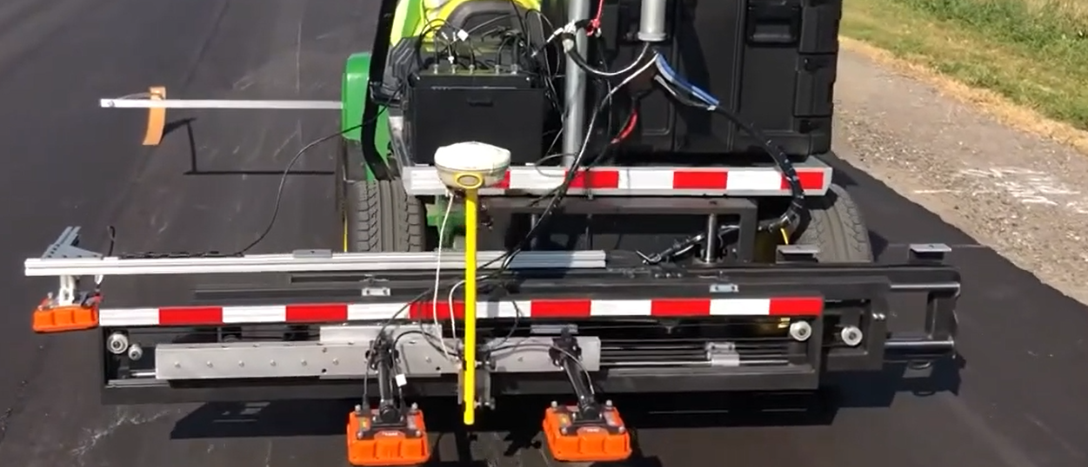
Use of DPS for Acceptance: Challenges and Potential Solutions
Kyle Hoegh, MnDOT
Dennis Dvorak, FHWA

Slide 2
Acceptance Methods
Agency DPS
Contractor DPS verified by agency DPS
Contractor DPS verified by other method such as cores

Slide 3
Minimum Requirements for DPS HMA Density Acceptance
Challenge: Ensure correct equipment is used
Challenge: Ensure sensors are consistent throughout day and project
Challenge: Ensure dielectric to density conversion is accurate for the full range of field density
Challenge: Ensure routine collection used for acceptance evaluation is collected correctly
These challenges need to be overcome and procedures developed so that agencies can accept HMA density nondestructively with the improved coverage DPS offers!

Slide 4
Core Elements of a Quality Assurance Program
QA Program
Agency Acceptance
Independent Assurance
Personnel Qualification
Lab Qualification
Dispute Resolution
Contractor QC

Slide 5
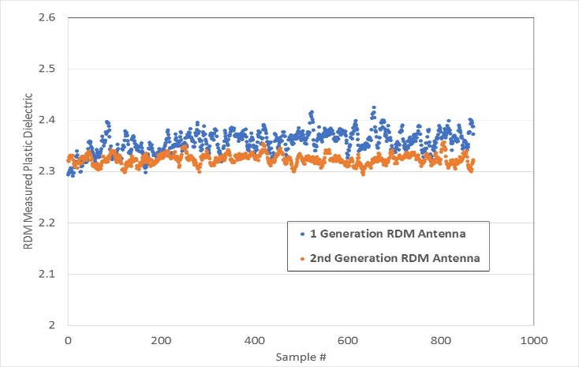
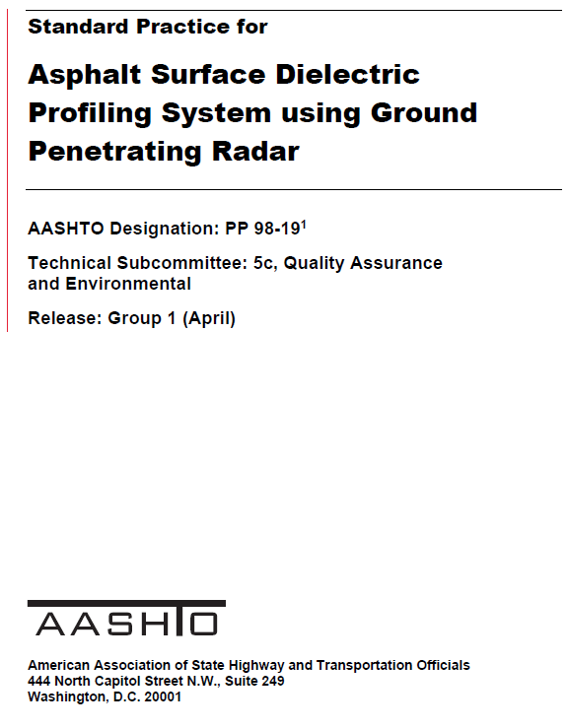
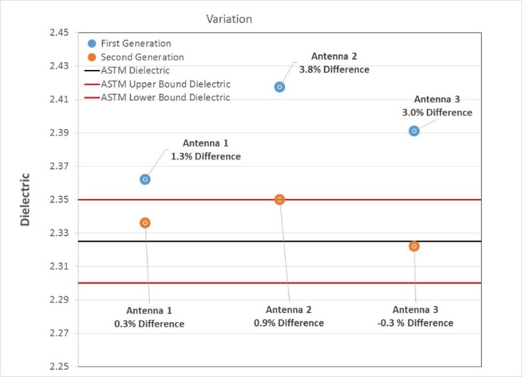
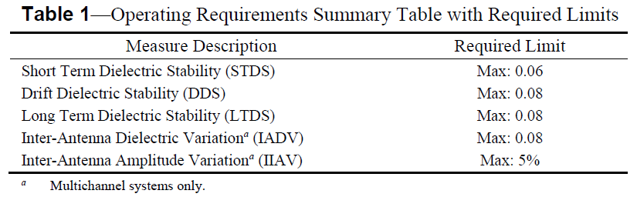
Challenge: Ensure Equipment is Precise/Unbiased–
How can I make sure I am using the right equipment?
The method requires an instrument capable of
  Scanning at a rate that allows for continuous collection behind the paving operation
  Measuring an accurate dielectric
Developed method based on plastic with known dielectric constant (HDPE)
Solution: AASHTO PP 98-19 specification
  Draft spec published
  Should be reviewed

Slide 6
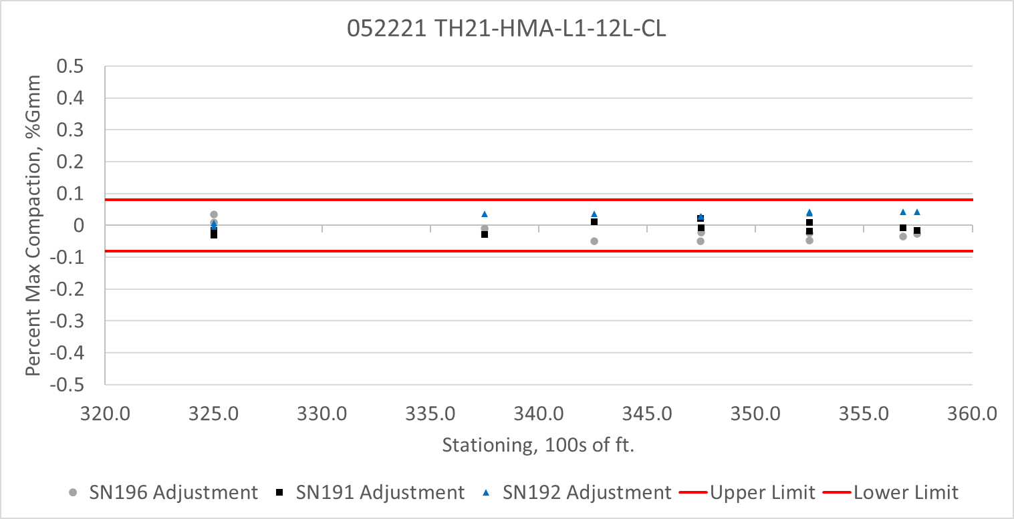
Challenge: Ensure Field Collection is Consistent –
How can I make sure my data is of the necessary quality?
Solution: Consistency checks to make sure sensors are working properly
  Method: Make sure all sensors give the same answer (within 0.08) when testing the same population
    Swerve: Can also be used as a mat assessment but not well defined
    Line test: Well defined but can’t always be done in transverse direction and requires accurate measurement to ensure all sensors are along the same line
    HDPE: not recommended (doesn’t correspond to AC consistency)
    Possible future: Garolite or other material closer to AC in dielectric range

Slide 7
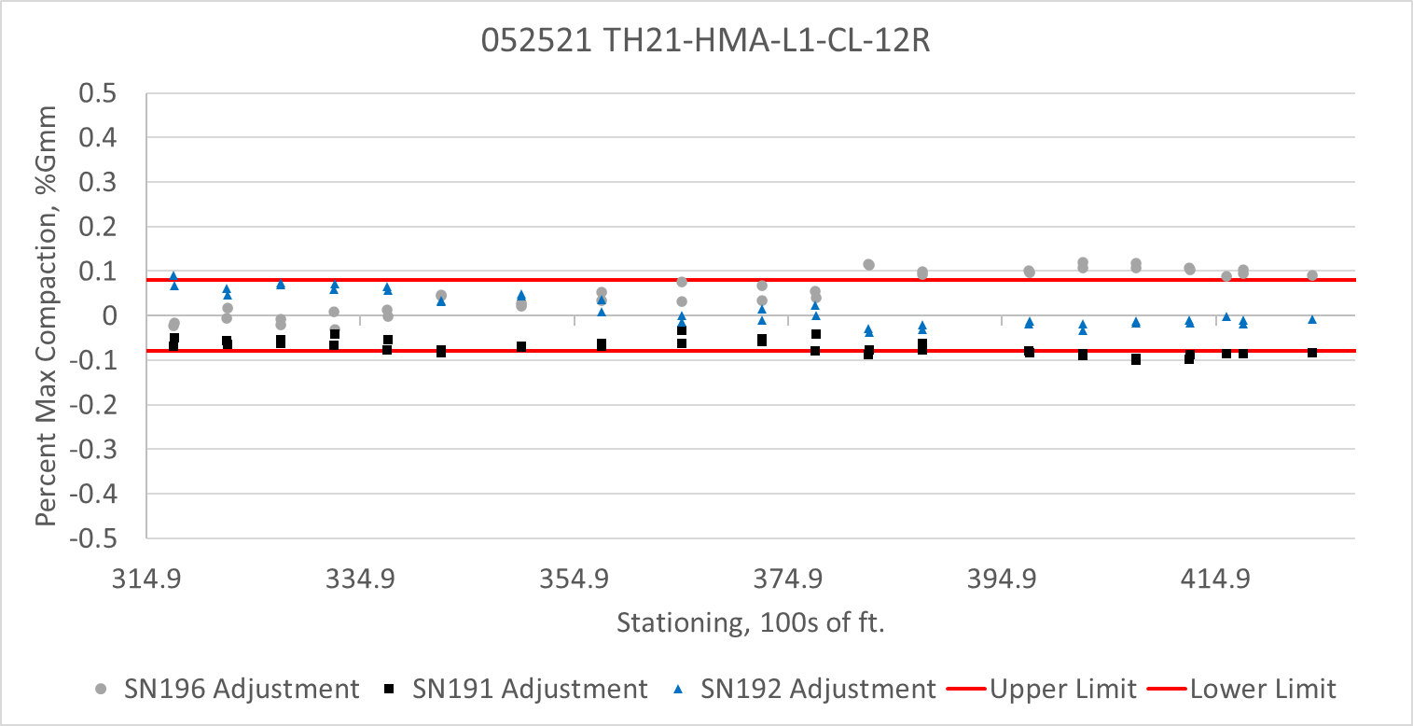
Challenge: Ensure Field Collection is Consistent –
How can I make sure my data is of the necessary quality?
Questions?
  What do we do when a sensor is out of range?
    Require re-calibration?
    Can we justify standardizing the sensors based on these tests with a scalar shift?
    Revert to coring if a certain amount of consistency failures?
    Revert to 2 sensors?
  How often does the consistency need to be evaluated?
    Beginning and end of day enough?
    Currently specifying at least every 4000 ft or 4 hours whatever comes first, but does this need to be justified quantitatively?
  If using contractor collected data for acceptance how often does agency random sampling need to occur? (discussed later)

Slide 8
Acceptance Methods
Agency DPS
Contractor DPS verified by agency DPS
Contractor DPS verified by other method such as cores

Slide 9
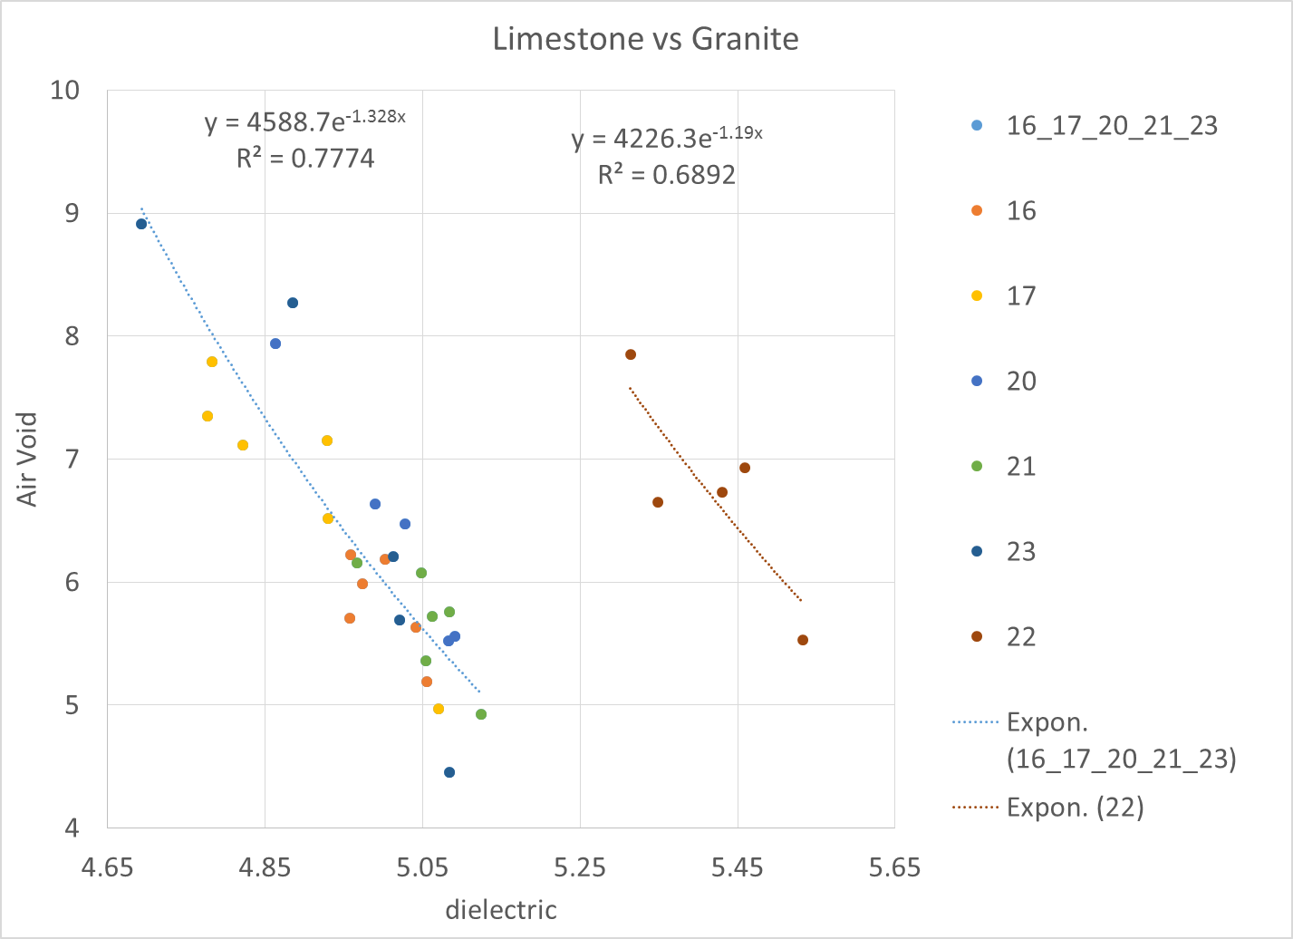
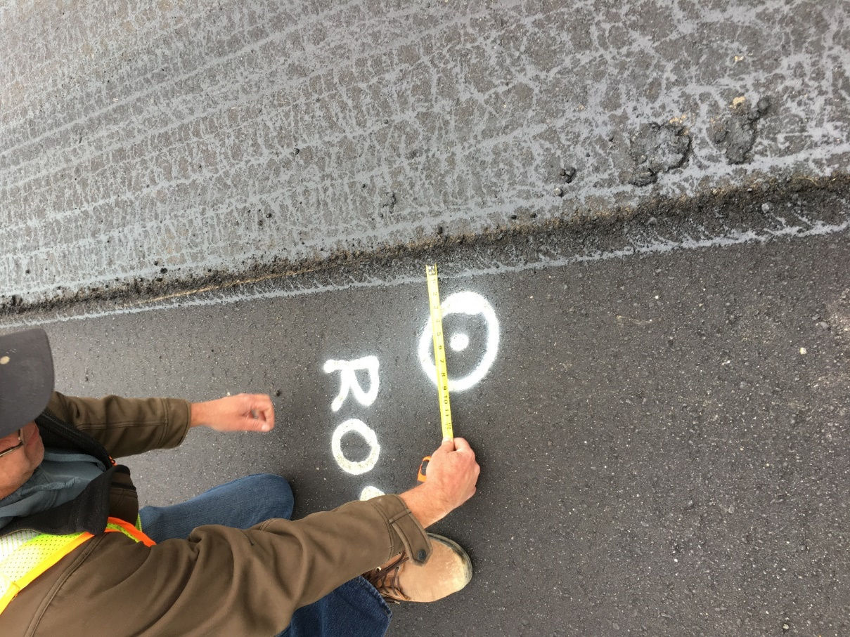
Challenge: Ensure Dielectric to Density Correlation is Accurate –
Converting what we measure to what we care about
Questions?
  How many cores are required to develop an accurate conversion?
  How do you specify core locations to ensure you get the full range of voids?
  How often do you need to perform a new conversion curve?
  How do you accept or reject your core develop dielectric to?
  How do you create your conversion curve and test the accuracy without taking too many cores?
Traditional Solution:
Develop Correlation with Field Cores

Slide 10
Acceptance Methods
Agency DPS
Contractor DPS verified by agency DPS
Contractor DPS verified by other method such as cores

Slide 11
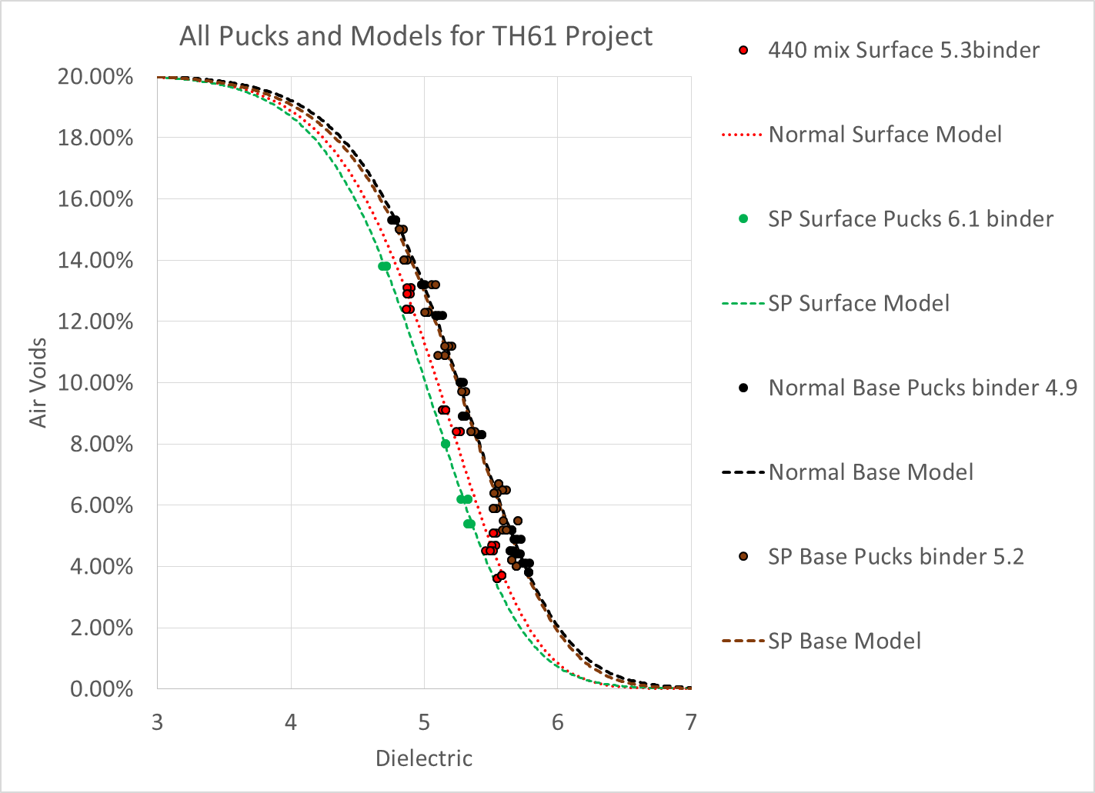
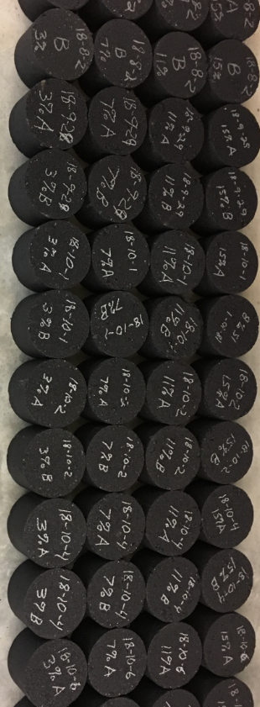
Challenge: Ensure Dielectric to Density Correlation is Accurate –
Converting what we measure to what we care about
Advantages over traditional way:
  Non-destructive
    Proven to detect changes in mix without cutting any cores in pavement
  Can ensure full range of air voids to develop conversion from dielectric to density
  More stable dielectric measurement than surface reflection field measurement: higher precision and covers entire thickness
  Easily integrated into the laboratory process
    Minimizes field operations disruption
    No additional staff (tech who gyrates pucks tests pucks for dielectric before dunking)
  Has potential value beyond DPS for monitoring mix property changes
New Solution: Develop Correlation with Production Mix Gyratory Samples

Slide 12
Challenge: Ensure Dielectric to Density Correlation is Accurate –
Converting what we measure to what we care about
Questions: How often does the sensor consistency need to be checked?
  Research to date shows very little variation from sensor to sensor
  Currently specifying top, rotate 90 degrees, and bottom measurement
    Max 0.05 variation criteria
  HDPE appears to work for this, but never observed a sensor being extremely biased for puck measurements
New Solution: Develop Correlation with Production Mix Gyratory Samples

Slide 13
Challenge: Ensure Dielectric to Density Correlation is Accurate –
Converting what we measure to what we care about
Questions: What range of densities should be tested?
  Currently using production mix design voids pucks then removing mix and gyrating to same height to hit full range of voids.
    Typically ranges from 4% to 12% voids
    Higher voids cause more variability
    May look into tightening to keep range within 2% to 10% voids to reduce variability
New Solution: Develop Correlation with Production Mix Gyratory Samples

Slide 14
Challenge: Ensure Dielectric to Density Correlation is Accurate –
Converting what we measure to what we care about
Questions: How often should we test?
  Currently adding higher void pucks one sample (1000 tons per day) and testing every puck fabricated to monitor for changes in dielectric properties
    Generally very little change from sample to sample, day to day of the same mix unless aggregate swaps occur
    Change to only fabricating new high void pucks if change in dielectric properties occurs
New Solution: Develop Correlation with Production Mix Gyratory Samples

Slide 15
Challenge: Ensure Dielectric to Density Correlation is Accurate –
Converting what we measure to what we care about
Questions: How to we handle high sensitivity to puck thickness?
  Currently use gyratory readout and save 1 puck per day for thickness verification using touch probe thickness setup
    Reasonable to have a touch probe verification and how often is it needed?
    Required accuracy? 1 mm = approximately 1% Air voids
    Ensure gyratory compactors are calibrated for thickness. How often?
    Error in specifying height instead of number of gyrations?
New Solution: Develop Correlation with Production Mix Gyratory Samples

Slide 16
Acceptance Methods
Agency DPS
Contractor DPS verified by agency DPS
Contractor DPS verified by other method such as cores

Slide 17
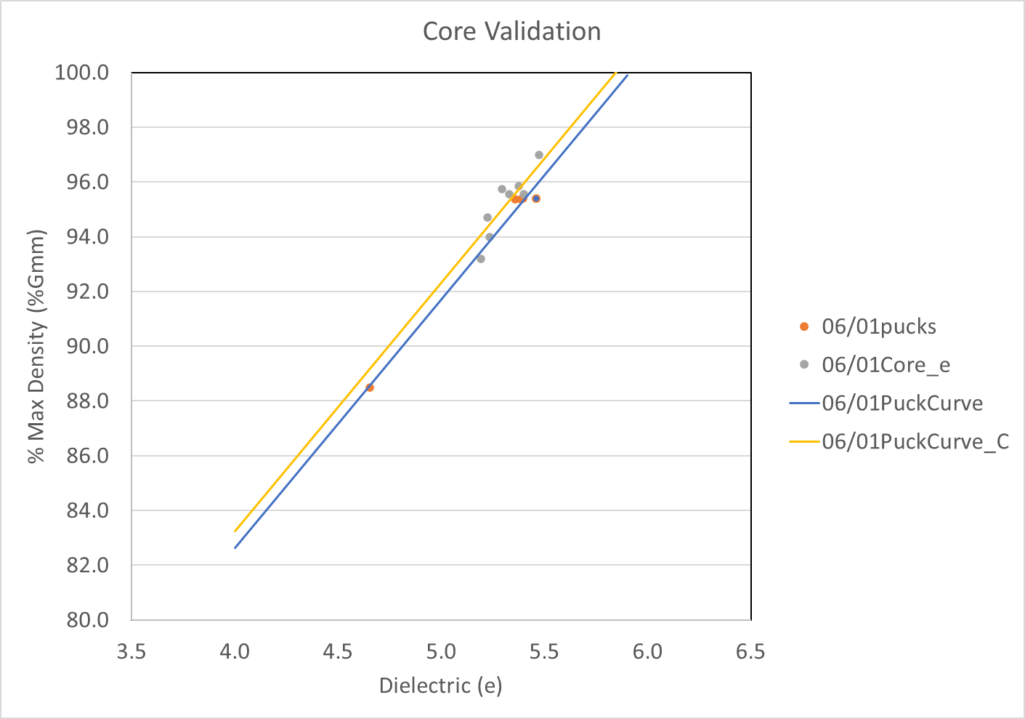
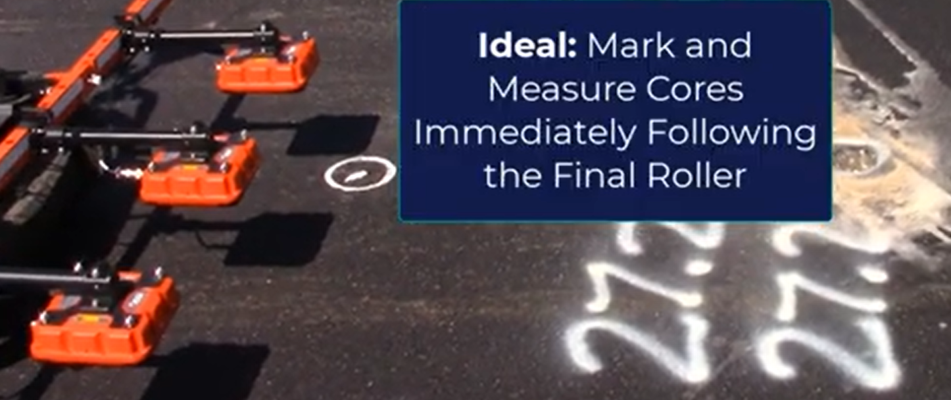
Challenge: Ensure Dielectric to Density Correlation is Accurate –
Converting what we measure to what we care about
Questions: How can we evaluate the accuracy of the dielectric to density conversion?
  Ideal situation: Use locations already randomly selected for density acceptance and collect a distance based dielectric measurement in core mode
    Same conditions as routine analysis used for acceptance
  Challenges
    Agency must mark location and contractor can’t know until done rolling
    Changes in paving from planned makes pre-paving random selection difficult
    Takes time to measure cores while collecting in routine collection mode (can be a problem for partial closures with quick turnaround time)
    Can be very late before final roller finishes at night

Slide 18
Challenge: Ensure Dielectric to Density Correlation is Accurate –
Converting what we measure to what we care about
Questions: How can we evaluate the accuracy of the dielectric to density conversion?
  Alternative method: Core the following morning prior to cutting cores
    Conditions can change: wet pavement from overnight rain event
    Need consistency check to ensure sensors are in same condition as data used for acceptance from previous day
    Equipment not convenient to move between core locations quickly

Slide 19
Challenge: Ensure Dielectric to Density Correlation is Accurate –
Converting what we measure to what we care about
Questions: How can we evaluate the accuracy of the dielectric to density conversion?
  Alternative method: Don’t worry about using existing acceptance cores and just take extra randomly throughout the day
    Not attractive to districts (we’ve been telling them no extra cores the last two construction seasons)
    Still need to be at predefined locations if part of density acceptance specification

Slide 20
Challenge: Ensure Dielectric to Density Correlation is Accurate –
Converting what we measure to what we care about
Questions: How can we evaluate the accuracy of the dielectric to density conversion?
  Alternative method: Select core locations only from collected DPS locations
    Requires accurate GPS
    Does it still need to be random or could we statistically decide locations (ex. 10th percentile and 90th percentile locations)
    Requires no extra collection during paving and ensures exact data used for acceptance is also used to check accuracy of density conversion

Slide 21
Challenge: Ensure Dielectric to Density Correlation is Accurate –
Converting what we measure to what we care about
Questions: How do we quantitatively assess agreement between cores and predictions?
  Currently based on 0.03 Gmb criterial ~ +/- 1.2%Gmm off predicted line
  UNH to look at statistical acceptance criteria

Slide 22
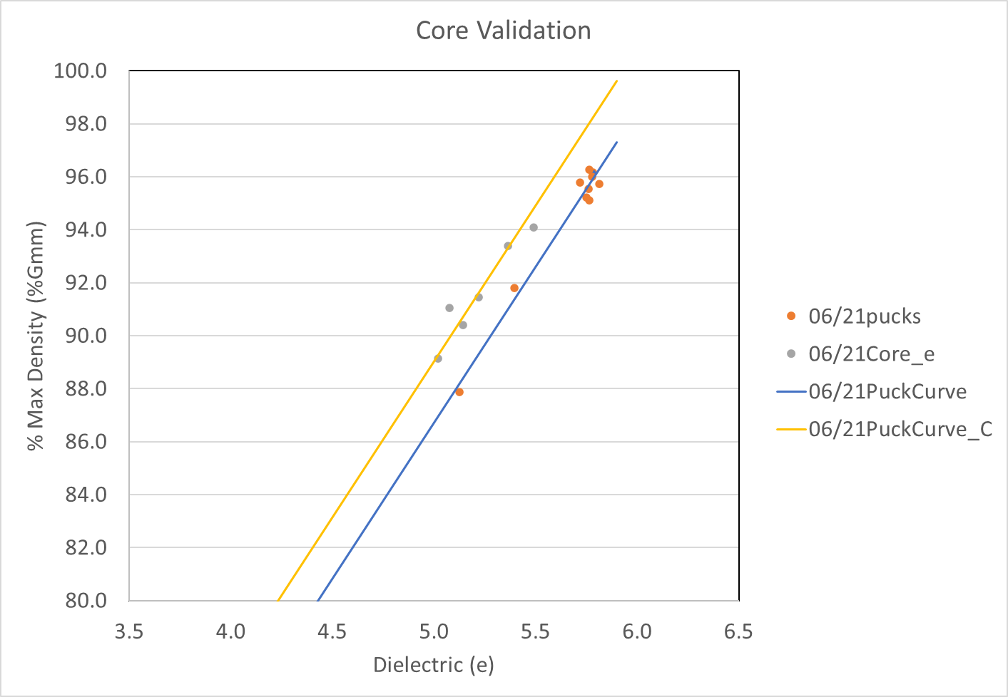
Challenge: Ensure Dielectric to Density Correlation is Accurate –
Converting what we measure to what we care about
Questions: What do we do if there is observed bias between predictions and cores?
  Revert to cores?
  Standardize prediction to match core shift?
  UNH to look at process to make recommendations

Slide 23
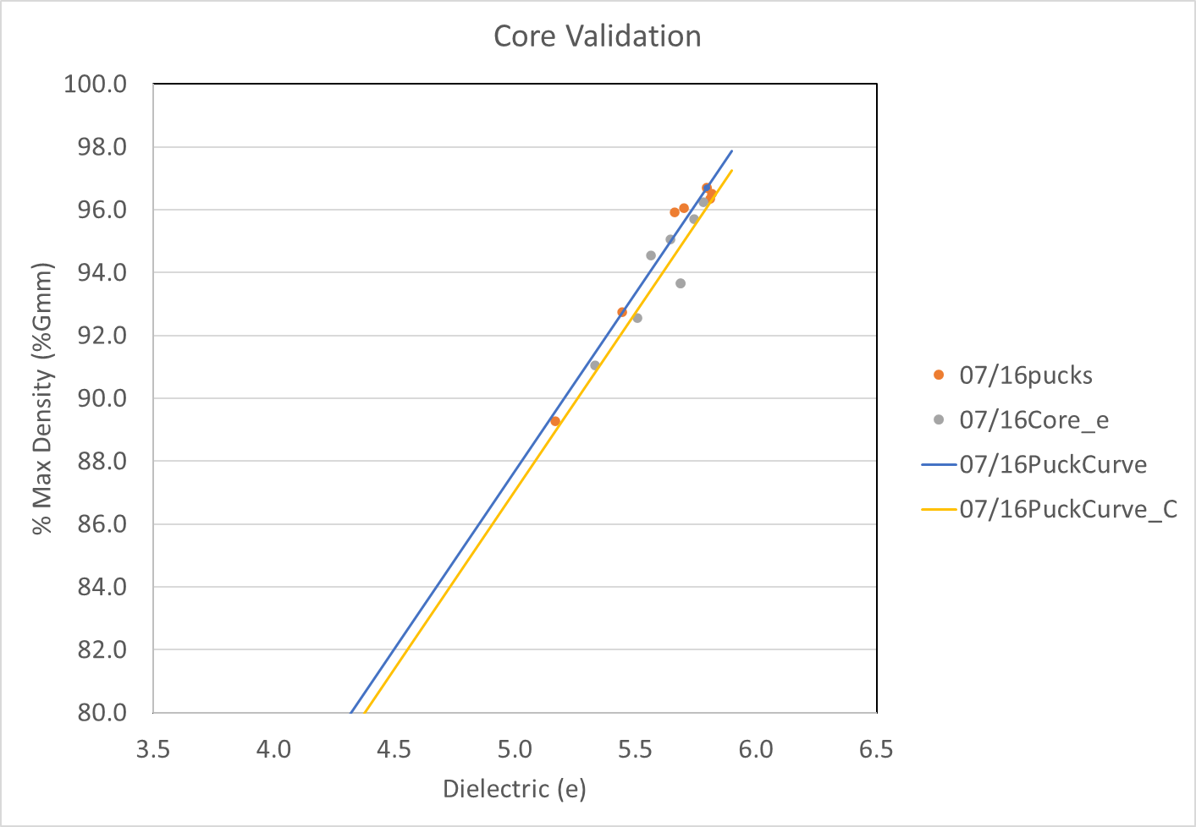
Challenge: Ensure Dielectric to Density Correlation is Accurate –
Converting what we measure to what we care about
Questions: How many cores do we need to check accuracy of predictions and how often?
  How many each day?
  Criteria that triggers more or less cores based on results?

Slide 24
Acceptance Methods
Agency DPS
Contractor DPS verified by agency DPS
Contractor DPS verified by other method such as cores

Slide 25
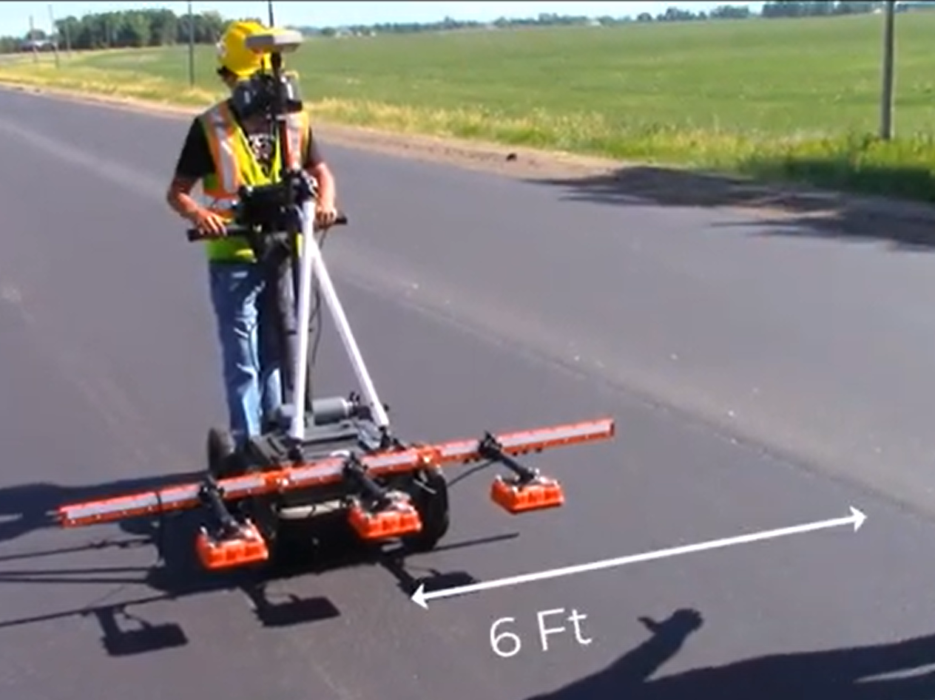
Challenge: Ensure routine collection used for acceptance evaluation is collected correctly
Current solution
  Specify data collection pattern
  Contractor collects routine data
  Random sampling with agency equipment
    Global medians must be within 0.1 (similar to criteria of multiple sensors within same unit)
  Require high accuracy GPS and monitor location

Slide 26
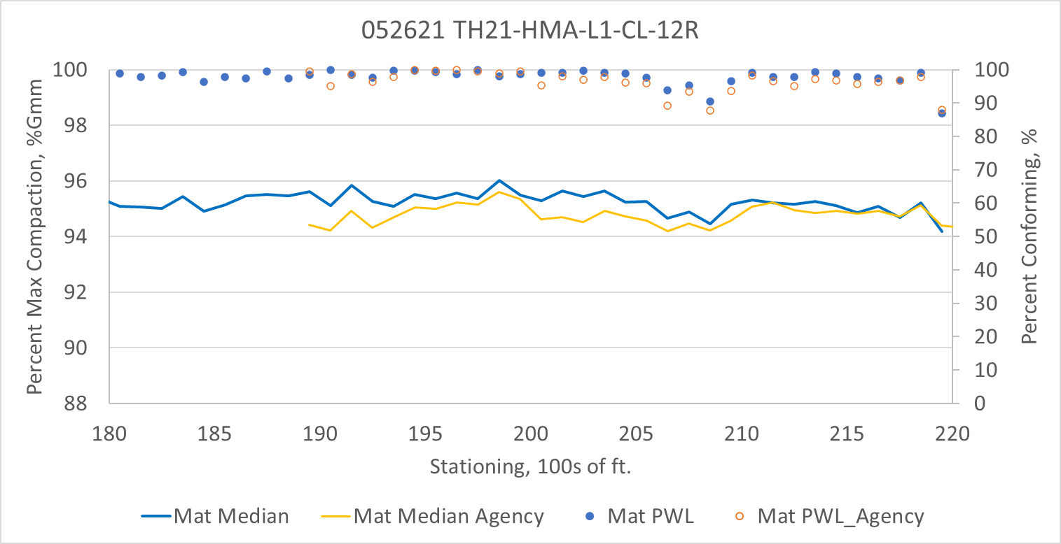
Challenge: Ensure routine collection used for acceptance evaluation is collected correctly
Questions
  Is GPS good enough even if high accuracy?
    Ex. As built joint doesn’t match as designed joint
  How often do we need agency sampling of contractor collected data?
  How to handle different Manufacturers (center frequency)?

Slide 27
Thank you again!
Kyle Hoegh
kyle.hoegh@state.mn.us
507-398-2669

